Slide 1
The Smart Dispenser
By Daniel Lawton

Slide 2

Contents
Parts I used in my project
Use of Virtual pins
Why I picked these parts?
Project Features
Control servo motor using Blynk App
Motion sensor
Virtual LED
Future Ideas
Summary

Slide 3
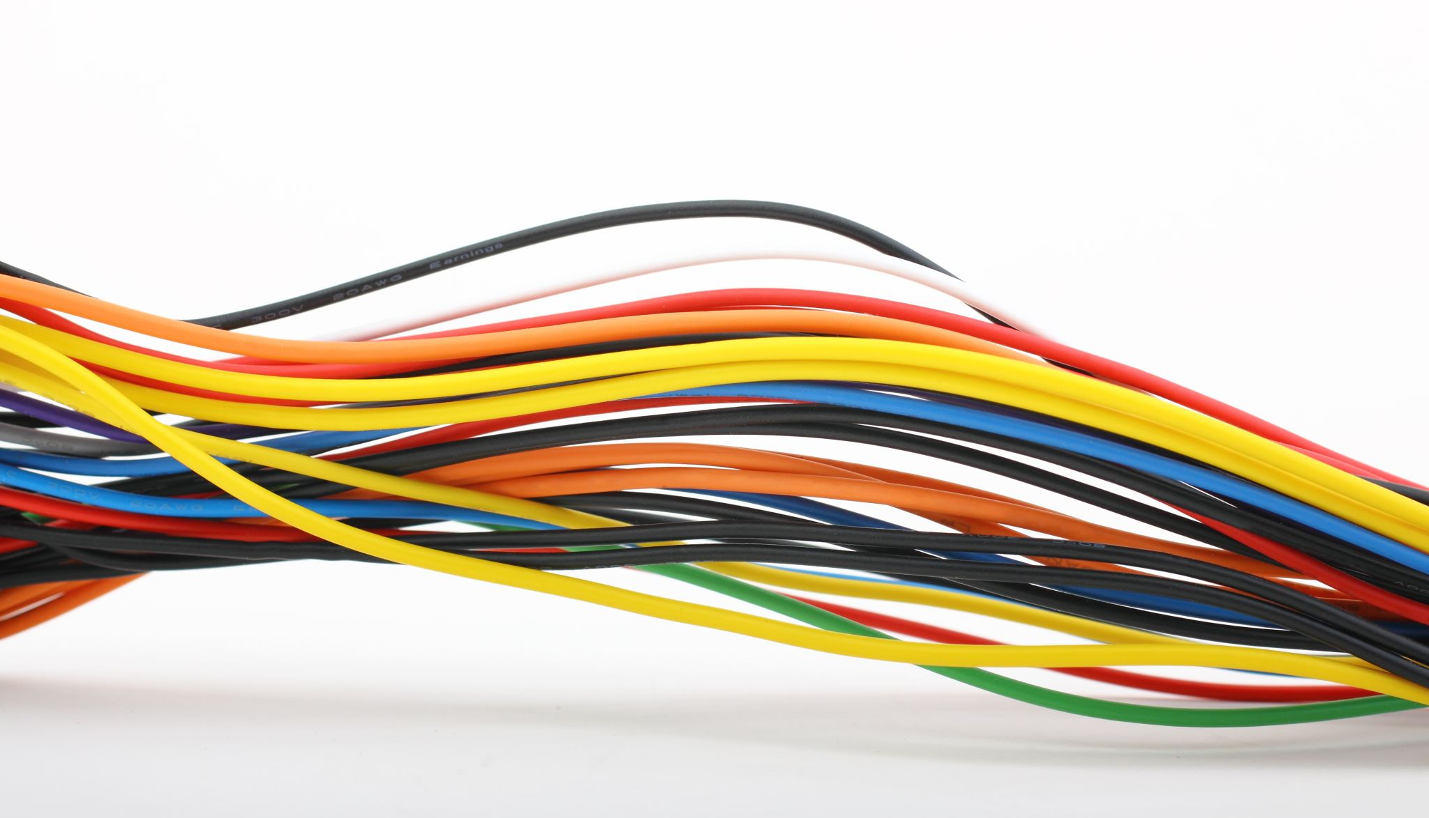
Parts I used in my project
Raspberry Pi
Servo motor
PIR Motion Sensor
Blynk
Jumper wires

Slide 4


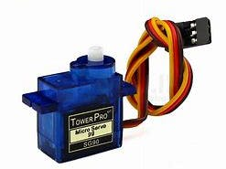
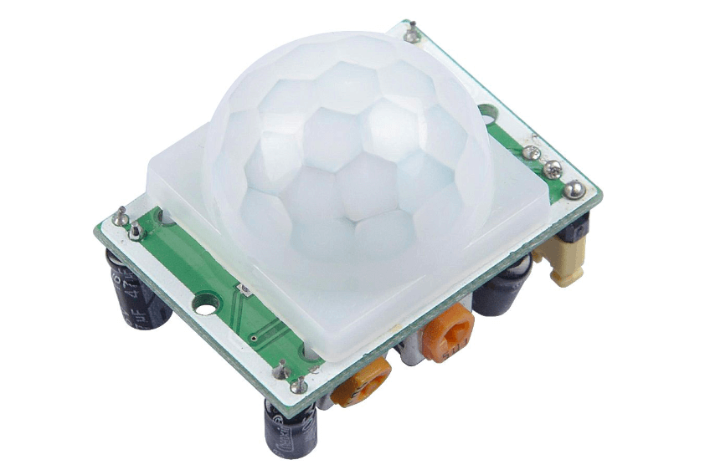
Why I picked these parts?
Raspberry Pi
Small, low-cost computer with a ton of compatibility, already have experience using the Raspberry Pi.
Servo motor
Easy to use perfect for prototyping ideas.
Blynk
Blynk promotes an open IOT platform with a wide variety of compatibility, being ideal for a project.
Motion Sensor
Extra feature to project adds a little more depth to project.

Slide 5

Project features
Control servo motor using virtual button.
Motion sensor
Virtual LED notification

Slide 6
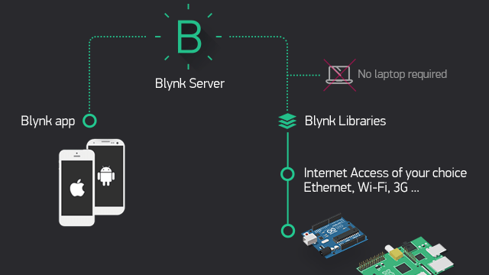
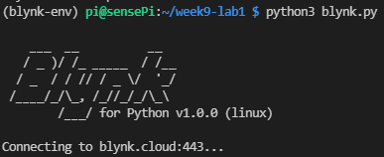
Control servo motor using Blynk app
With my idea of controlling the servo motor through my phone, Blynk was a perfect tool to achieve this.
With a built-in app available on android, it allowed me to control my servo motor through Blynk’s compatibility with the raspberry Pi.
Using Blynk I could easily connect my servomotor to the raspberry Pi and through Linux terminal create a script of code to give commands to the App

Slide 7
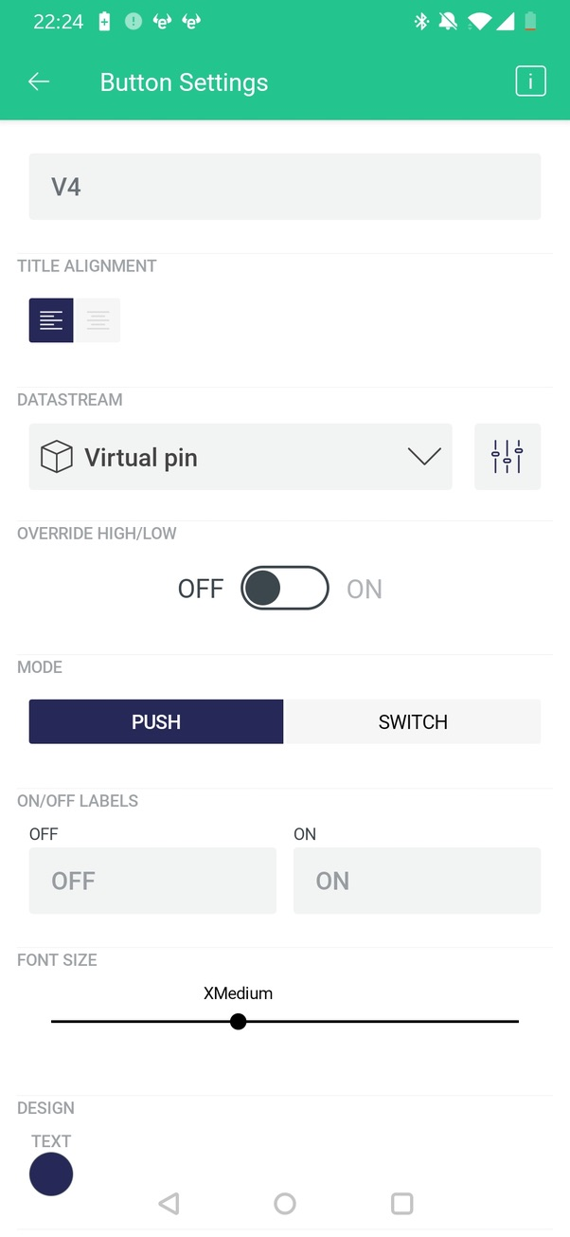
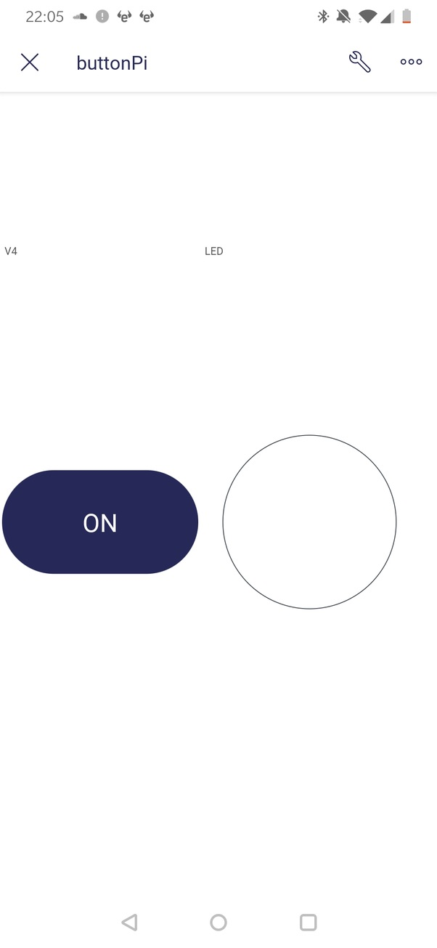
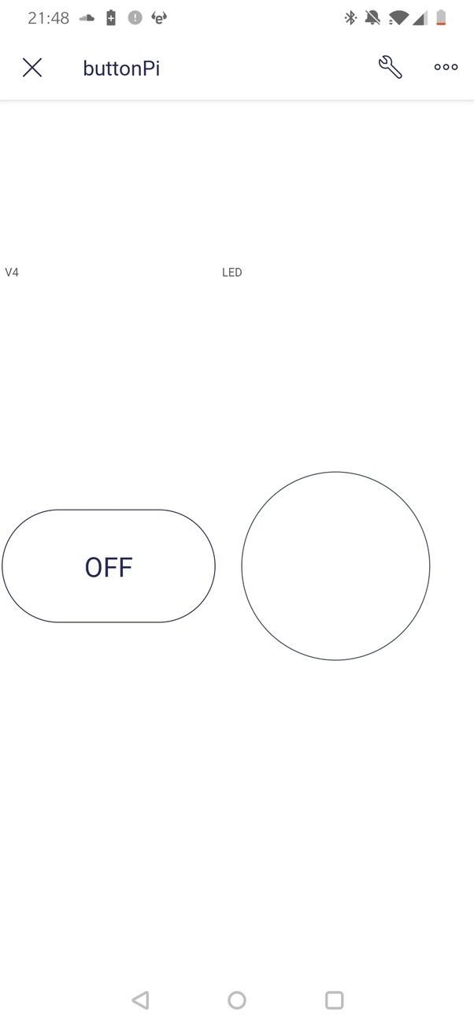
Use of Virtual Pins
Virtual Pins are used by Blynk to exchange data between your Blynk app and the hardware you are using.

Slide 8
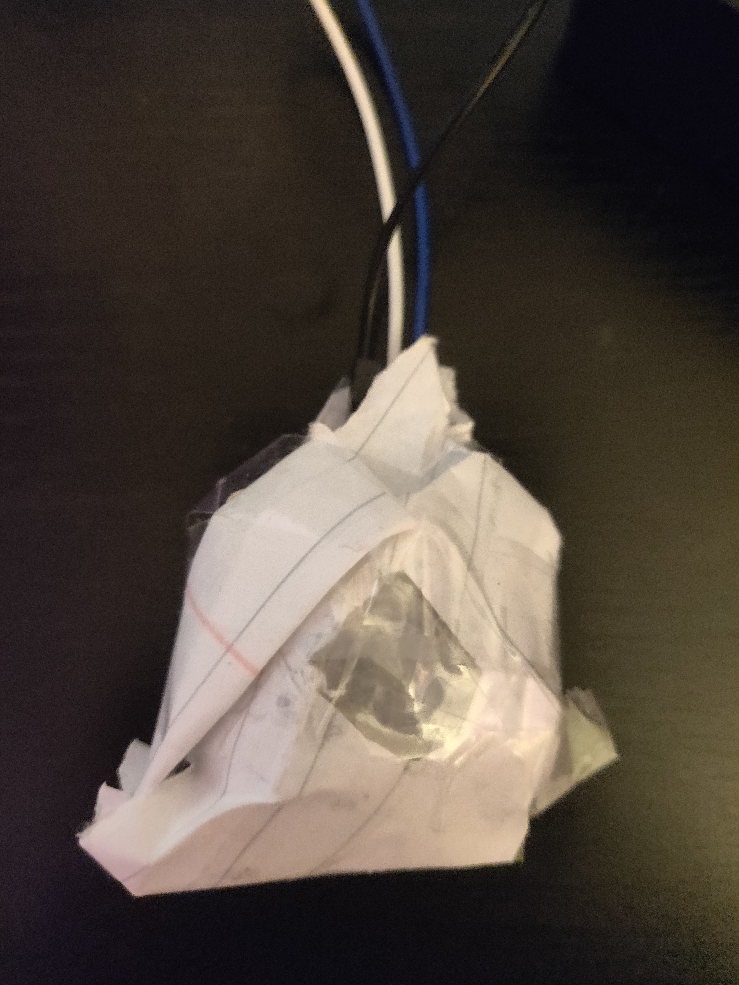
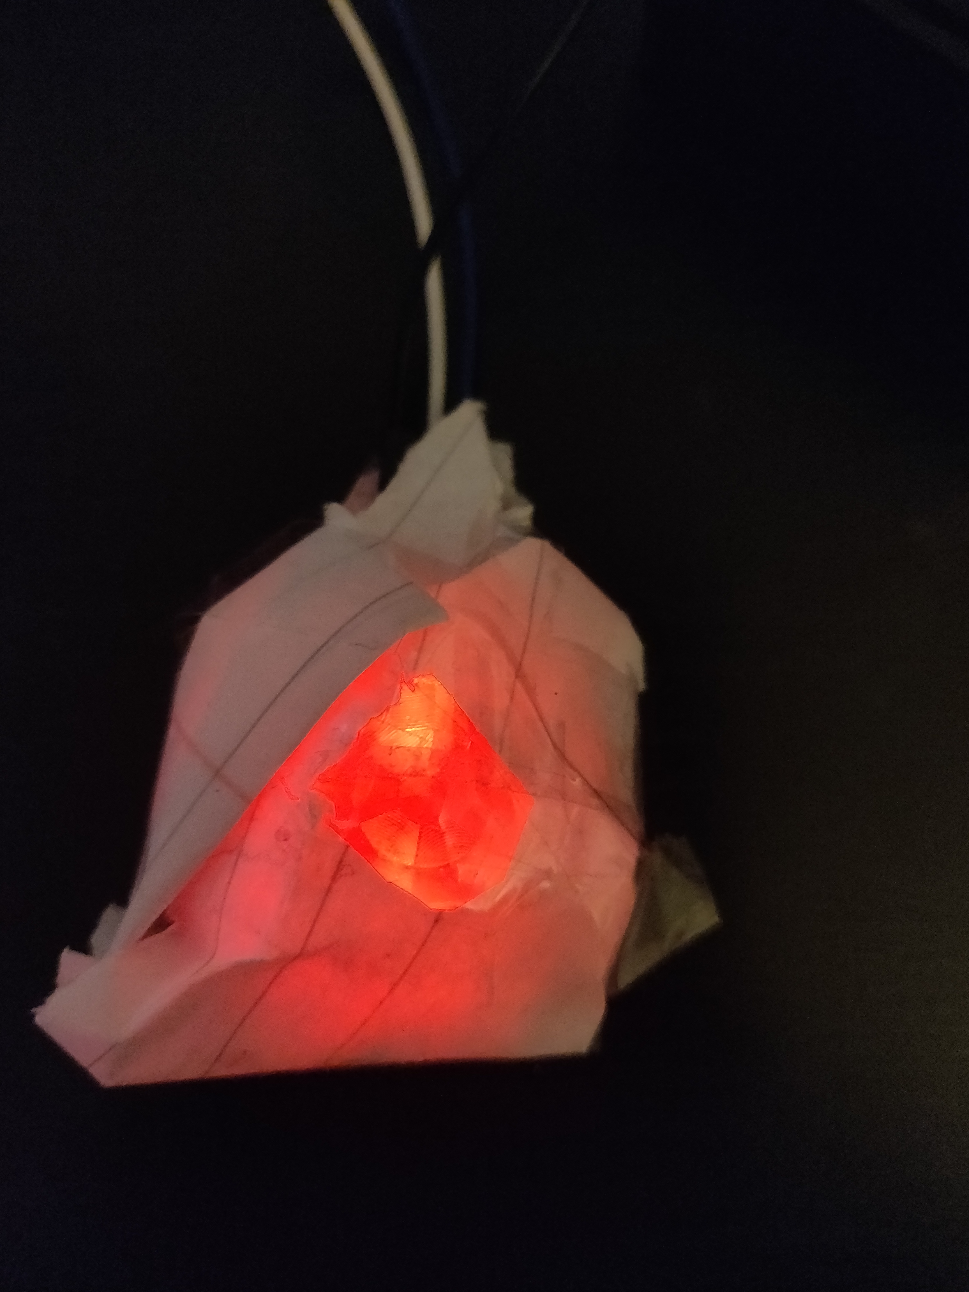
Motion sensor
A PIR motion senser was connected to the raspberry Pi using jumper wires.
Using Nano text editor in terminal The script was developed with the objective to cause the servo motor to move when the motion sensor detects motion.

Slide 9
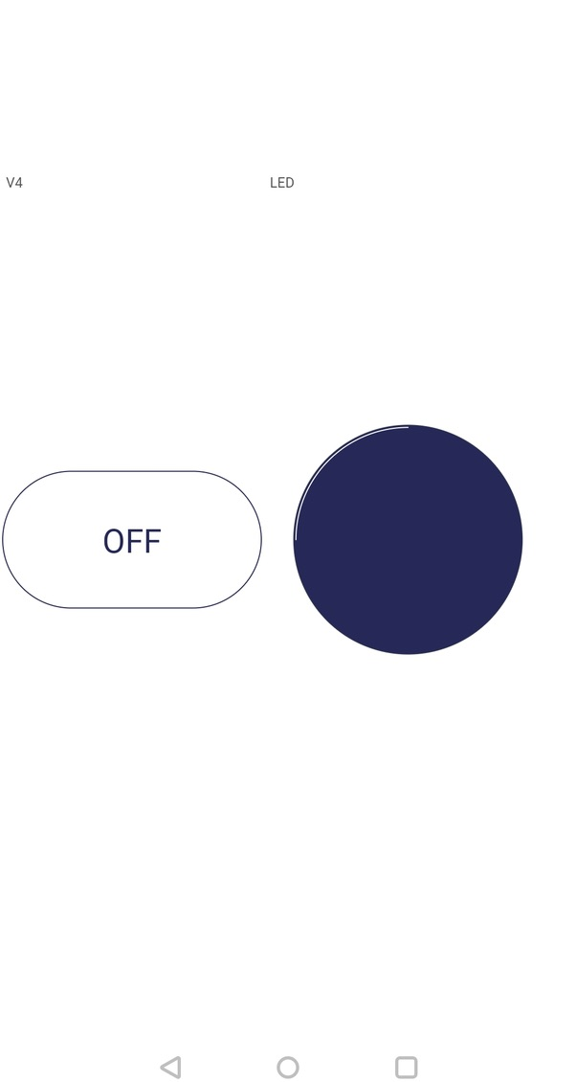
Virtual LED
Using Blynk I Created a Virtual LED which when motion was detected, will change colour.
Like for the On/Off Button you pick a Virtual Pin in the DataStream and add it to a widget in this case the LED widget.

Slide 10
Using Blynk I could easily connect my servomotor to the raspberry Pi and through Linux terminal create a script of code and run it.

Slide 11
Blynk
Blynk is an IoT platform which allows users to develop interfaces that control and monitor your Hardware projects through the cloud.
With my idea of controlling the servo motor through my phone, Blynk was a perfect tool to achieve this.
With a built-in app available on android, it allowed me to control my servo motor through Blynks compatibility with raspberry Pi.

Slide 12
What I would do different?
A problem in the completion of this project was trying to narrow down the core functions I wanted as the features of this project.
I would try use GitHub in a much more regular basis, creating a repository with constant updates to help prevent backtracking if code stopped working.
Have solid version control throughout the project.

Slide 13
Final Thoughts
By only skimming the surface of IOT and seeing the ever more increasing importance of how it acts as the backbone of almost all modern technologies being released.
I see now how instrumental autonomy is and the endless uses it has for all aspects of life.

Slide 14
Python code

